Slide 1
Fonter
Team Hack O’ Holics

Slide 3
Features:
Save time, money and resources - Helps save money in the form of paper,etc.The time saved by the user can be better utilised to do other things.Since less paper is used it also works in the favor of preserving our environment.
Personalised font for your use
Use your voice to write using your own font - This is your personal voice activated handwriting.
Simple to use from camera - No need to buy any extra expensive equipment, the software works with any ordinary pre existing camera.

Slide 6
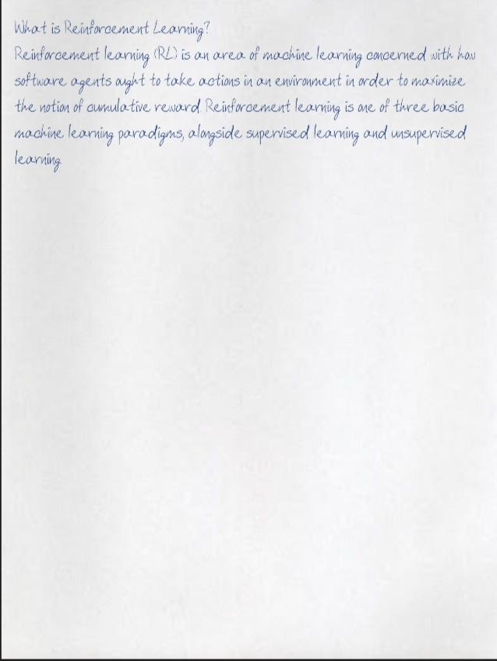
This is how text will look after you speak .

Slide 7
Experimental features/ future plans
Translation into latin languages from english. (text- to speech)
Adding other scripts Devanagari, Traditional Chinese, etc.
Adding AI & ML - In the future the software will be able to recognize the typical patterns in which z
Designed as a wizard.

Slide 9
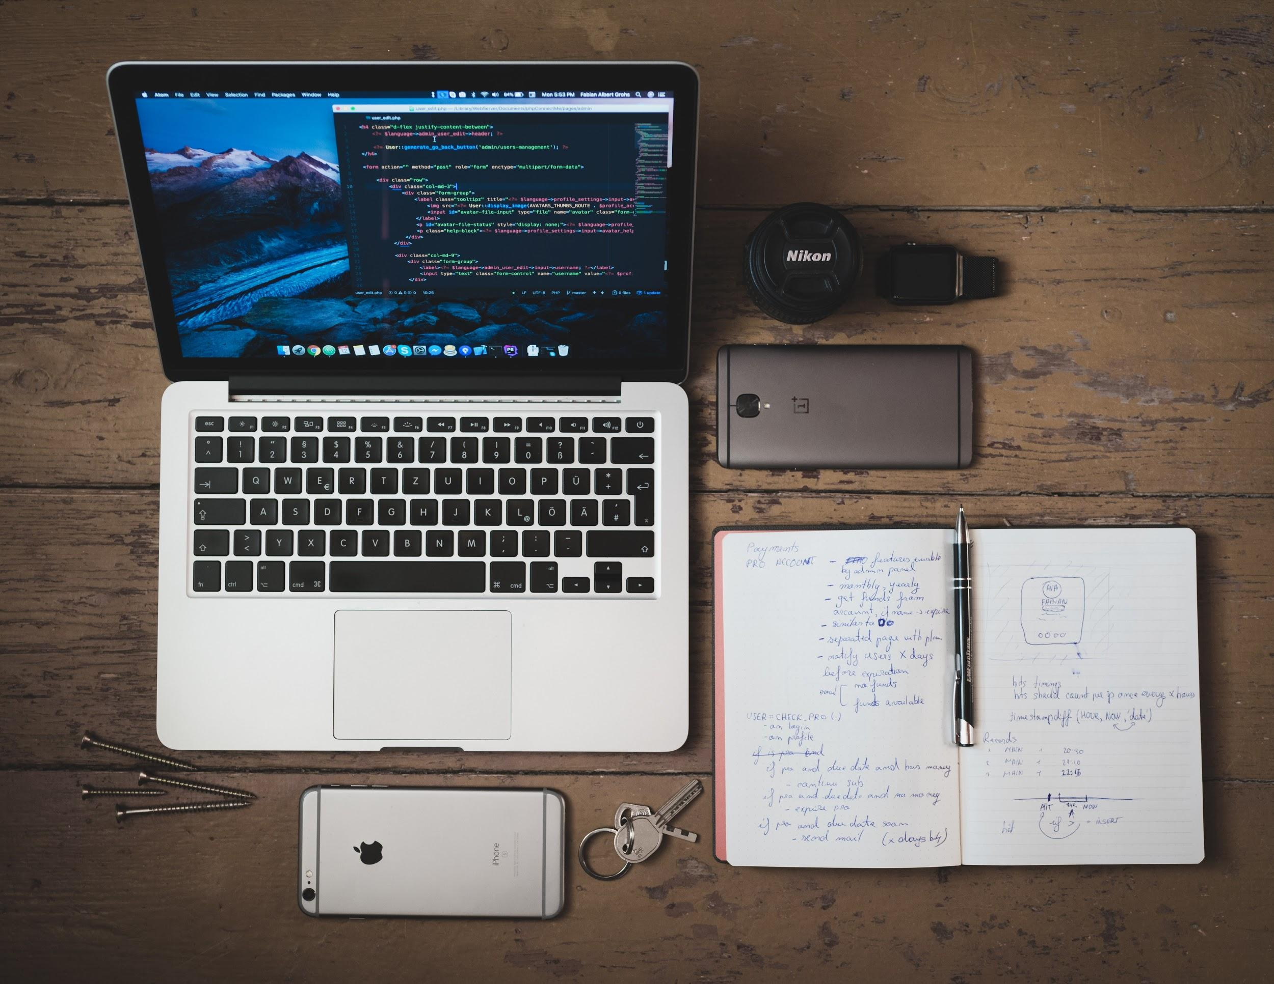
Conclusion

Slide 10
Thank You!
By,
>Aby Anthony >Harssh Rane >Richie Patil >Gaurav Bhanot

